Slide 1
SIP and NAT
Dr. Jonathan Rosenberg
Cisco Fellow

Slide 2
What is NAT?
Network Address Translation (NAT)
Creates address binding between internal private and external public address
Modifies IP Addresses/Ports in Packets
Benefits
Avoids network renumbering on change of provider
Allows multiplexing of multiple private addresses into a single public address ($$ savings)
Maintains privacy of internal addresses
S: 10.0.1.1:6554
D: 67.22.3.1:80
S: 1.2.3.4:8877
D: 67.22.3.1:80
IP Pkt
IP Pkt
N
A
T
Client
N
A
T
Binding Table
Internal External
10.0.1.1:6554 -> 1.2.3.4:8877

Slide 3
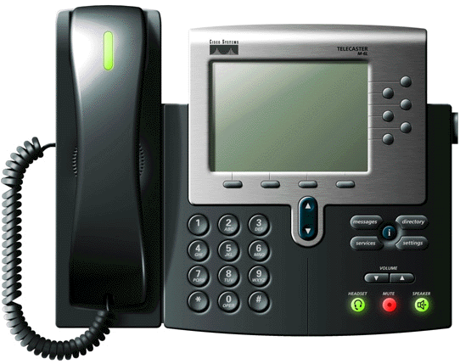
Problem: Getting SIP Through NATs
RTP to 10.0.1.1
N
A
T
INVITE sip:12345@b.com
m=audio 3456 RTP/AVP 0
c=IN IP4 10.0.1.1

Slide 4
Solution Space
Application Layer Gateways (ALGs)
Session Border Controllers (SBC)
Simple Traversal of UDP Through NAT (STUN)
Traversal Using Relay NAT (TURN)
Interactive Connectivity Establishment (ICE)

Slide 5
Application Layer Gateway
RTP to 10.0.1.1
INVITE sip:12345@b.com
m=audio 3456 RTP/AVP 0
c=IN IP4 10.0.1.1
N
A
T
INVITE sip:12345@b.com
m=audio 1234 RTP/AVP 0
c=IN IP4 19.1.3.2
ALG
NAT also modifies SIP
messages to fix them up!

Slide 6
ALG Benefits and Drawbacks
Drawbacks
Doesn’t work when security turned on
Hard to diagnose problems
Requires network upgrade to support new app
Frequent implementation problems (lack of expertise)
Incentives mismatched
Benefits
No change to clients or servers

Slide 7
Session Border Controller
9.8.7.6
INVITE sip:12345@b.com
m=audio 3456 RTP/AVP 0
c=IN IP4 10.0.1.1
N
A
T
INVITE sip:12345@b.com
m=audio 3225 RTP/AVP 0
c=IN IP4 9.8.7.6
SBC
SBC relays
RTP back to
source
RTP to
9.8.7.6

Slide 8
SBC Benefits and Drawbacks
Drawbacks
Expensive media relaying
Interferes with some SIP extensions
Breaks more advanced SIP security
Benefits
No change to clients or NATs
Works with basic SIP security mechanisms
Easier to diagnose

Slide 9
Simple Traversal of UDP Through NAT (STUN)
9.8.7.6
STUN
Server
N
A
T
What is my IP address
and port please?
1.2.3.4
Its
1.2.3.4: 3472
INVITE sip:12345@b.com
m=audio 3472 RTP/AVP 0
c=IN IP4 1.2.3.4
RTP to
1.2.3.4

Slide 10
STUN Benefits and Drawbacks
Drawbacks
Doesn’t always work
Benefits
No change to servers or NATs
Works with all SIP security mechanisms
Can support non-VoIP apps (e.g., games)

Slide 11
Traversal Using Relay NAT (TURN)
9.8.7.6
TURN
Server
N
A
T
Give me an IP address
and port please?
1.2.3.4
RTP to
1.2.3.4
9.8.7.6:
2376
INVITE sip:12345@b.com
m=audio 2376 RTP/AVP 0
c=IN IP4 9.8.7.6

Slide 12
TURN Benefits and Drawbacks
Drawbacks
Expensive Media Relaying
Benefits
No change to servers or NATs
Works with all SIP security mechanisms
Can support non-VoIP apps (e.g., games)

Slide 13
Interactive Connectivity Establishment (ICE)
Hybrid of STUN and TURN
P2P NAT Traversal
Widely Deployed on Internet
Popular with Application Providers

Slide 14
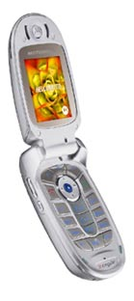
ICE Step 1: Allocation
Before Making a Call, the Client Gathers Candidates
Each candidate is a potential address for receiving media
Three different types of candidates
Host Candidates
Server Reflexive Candidates (STUN)
Relayed Candidates (TURN)
TURN candidates reside on a TURN server
STUN
TURN
STUN candidates
are addresses residing on a NAT
NAT
NAT
Host
Candidates reside on the agent itself

Slide 15
ICE Step 2: Create Offer
Each candidate is placed into an a=candidate attribute of the offer
Each candidate line has IP address and port plus other info needed for ICE
c=IN IP4 192.0.2.3
t=0 0
m=audio 45664 RTP/AVP 0
a=rtpmap:0 PCMU/8000
a=candidate:1 1 UDP 2130706178 10.0.1.1 8998 typ host
a=candidate:2 1 UDP 1694498562 192.0.2.3 45664 typ srflx raddr 10.0.1.1 rport 8998

Slide 16
ICE Step 3: Send INVITE
Caller sends a SIP INVITE as normal
No ICE processing by SIP servers
SIP
Server
INVITE

Slide 17
ICE Step 4: Allocation
Called party does exactly same processing as caller and obtains its candidates
Recommended to not yet ring the phone!
STUN
TURN
NAT
NAT

Slide 18
ICE Step 5: Provisional Response
Callee sends a provisional response containing its SDP with candidates
As with INVITE, no processing by proxies
Phone has still not rung yet
SIP
Proxy
1xx

Slide 19
ICE Step 6: Verification
Each agent pairs up its candidates (local) with its peers (remote) to form candidate pairs
Each agent sends a STUN-based ping on each pair, starting at highest priority
If a response is received the check has succeeded and we know media can flow on that pair!
TURN
Server
TURN
Server
5
4
NAT
2
NAT
NAT
3
NAT
1

Slide 20
ICE Benefits and Drawbacks
Drawbacks
Requires client changes
Requires other side to support it
Benefits
Always Works
No change to servers or NATs
Works with all SIP security mechanisms
Minimum Media Relaying
Can support non-VoIP apps (e.g., games)
Built-In Anti-DOS
Eliminates Ghost Rings

